Slide 1
Instant b & w sketch from live cam
Akshay Sasheendran

Slide 2
AGENDA
Introduction​
Primary goals
​Areas of growth
Timeline
​Summary​

Slide 3
Instant-B & W-Sketch-From-Live-Cam
Here the main idea is to convert the image into a grayscale and then blur the background. Then we will add the black and white foreground to the blurred image. To separate the background we will be inverting the image and then we will blur it, and our final output will be a pencil sketch of the provided image or the frame recorded in the webcam.

Slide 4
PRIMARY GOALS
Annual revenue growth

Slide 5
BUSINESS OPPORTUNITIES ARE LIKE BUSES. THERE'S ALWAYS ANOTHER ONE COMING.
“
”
Richard Branson

Slide 6





Live Sketch Algorithm
<<<< 1 >>>>
<<<< 2 >>>>
<<<< 3 >>>>
<<<< 4 >>>>
<<<< 5 >>>>
Capturing Real-time Video from the source example – computer’s camera
2.Reading each frame of the video, so that we can make manipulations on the frame.
3.Converting each frame from colored to grayscale, using OpenCV functions.
4.Making Use of Blurring on the grayscale image to remove all the noises.(Gaussian Blur)
5.Detecting Edges of the blurred image, for making it like a sketch of the person or object. (Canny Edge)

Slide 7
What is OpenCV
OpenCV (Open Source Computer Vision Library) is an open source computer vision and machine learning software library. OpenCV was built to provide a common infrastructure for computer vision applications and to accelerate use of machine perception in the commercial products
The library has more than 2500 optimized algorithms, which includes a comprehensive set of both classic and state-of-the-art computer vision and machine learning algorithms. These algorithms can be used to detect and recognize faces, identify objects, classify human actions in videos, track camera movements, track moving objects, extract 3D models of objects, produce 3D point clouds from stereo cameras, stitch images together to produce a high resolution image of an entire scene

Slide 8
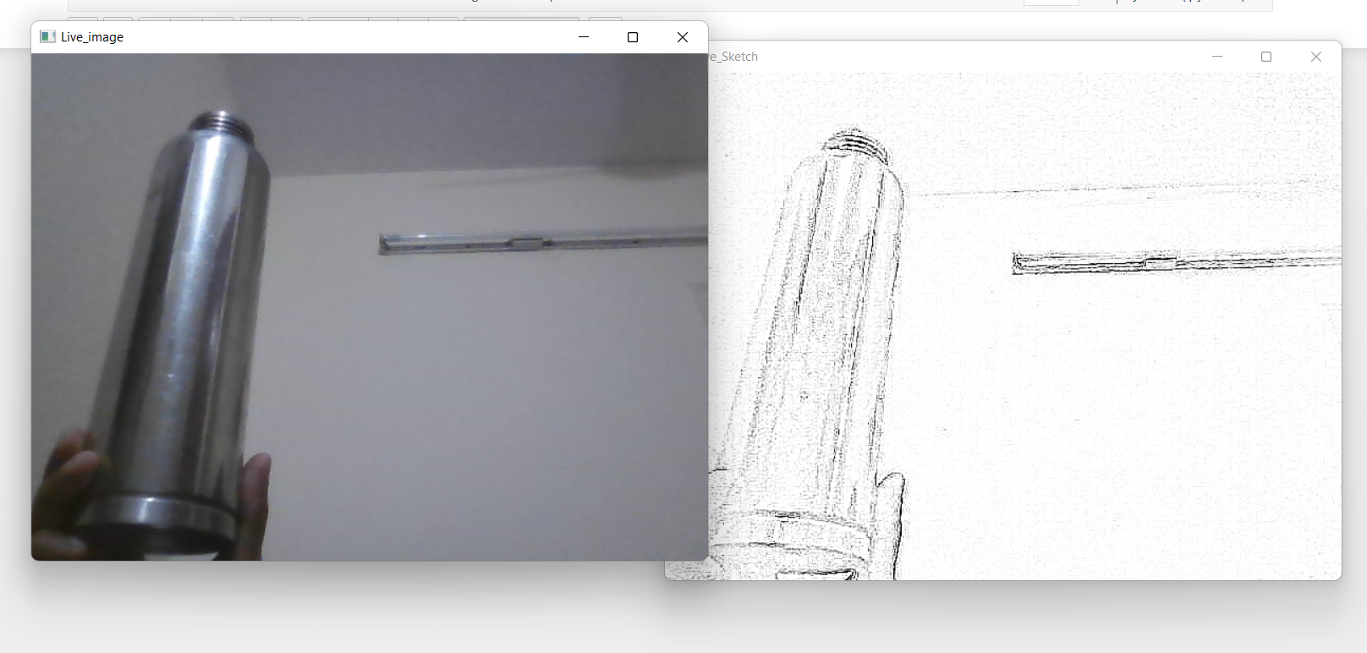
TIMELINE
SEP 20XX
NOV 20XX
JAN 20XX
MAR 20XX
MAY 20XX
Synergize scalable e-commerce
Disseminate standardized metrics
Coordinate e- business applications
Foster holistically superior methodologies
Deploy strategic networks with compelling e- business needs

Slide 9
SUMMARY
At Contoso, we believe in giving 110%. By using our next-generation data architecture, we help organizations virtually manage agile workflows. We thrive because of our market knowledge and great team behind our product. As our CEO says, "Efficiencies will come from proactively transforming how we do business."

Slide 10
THANK YOU

